Slide 1
Hospitality And Tourism
Checkpoint 2
COL865 Project
Garvit Dhawan (2020CS50425)
Pratik Nimbalkar (2020CS10607)
Nikhil Unavekar (2020CS10363)

Slide 2
Targets Accomplished
Analyzed government and makemytrip data to highlight the hotspots and quality of Hospitality industry in different cities of India at different times (pre and post COVID).
Formed WordCloud based on hotel reviews, analyzed sentiment distribution.
Segregated Reviews into different groups using Topic Modelling, Implemented Aspect Based Sentiment Analysis.
Derived Interpretations and Conclusions based on above analysis.
Build a Graphical User Interface (GUI) for easy, user-friendly data visualization for further needs.

Slide 3
Objective
India has a lot of opportunities in Tourism and Hospitality sector. There is a need for a Comprehensive analysis of the industry which will provide insights for research and development planning purposes.
We aim to gain valuable insights into the relationship between hospitality and tourism in India by analyzing data pertaining to various hotels and restaurants across different states and across different years.
Analyze the review data and other complimentary features to evaluate the quality of the hospitality industry across states and perform a comparative analysis.

Slide 4
Statistical Data Analysis of Govt Data

Slide 5
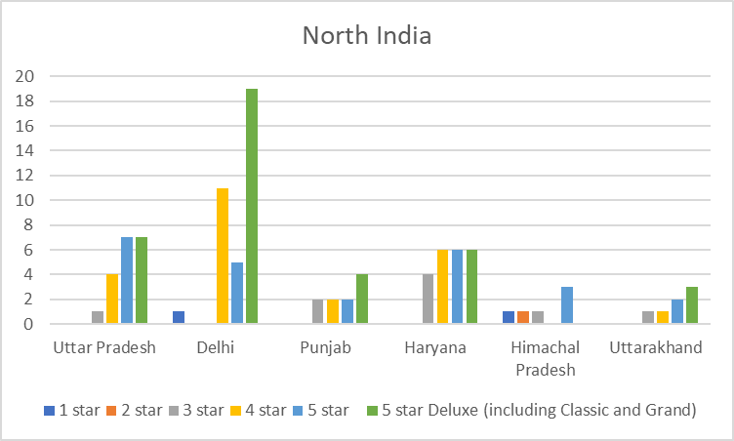
Distribution of Hotels across Indian states
North India
Much more 5 star and deluxe hotels (especially Delhi) as compared to others.
Uttarakhand and HP despite being tourist spots, have less no. of classical (approved) hotels due to scattered settlements and less work client guests.

Slide 6
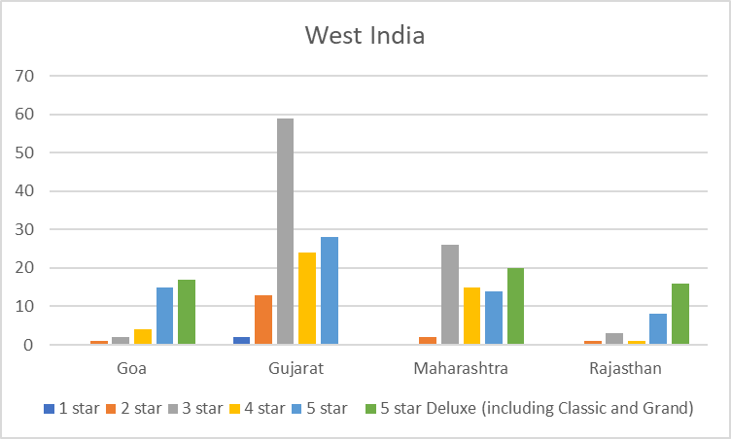
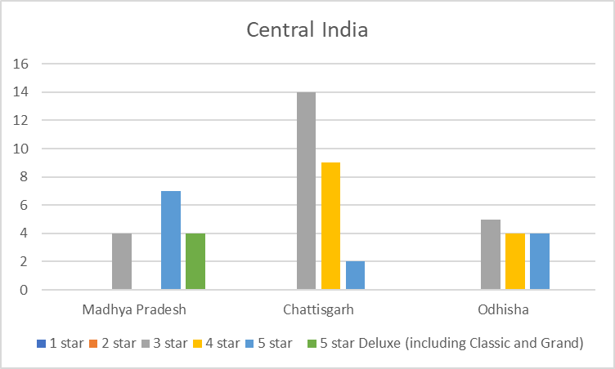
West India
Central India
West India has substantial number of hotels - especially 3 star ones.
No deluxe hotels in Gujarat.
Less hotels in Central India due to less Tourism and work client guests.
Deluxe hotels almost negligible

Slide 7
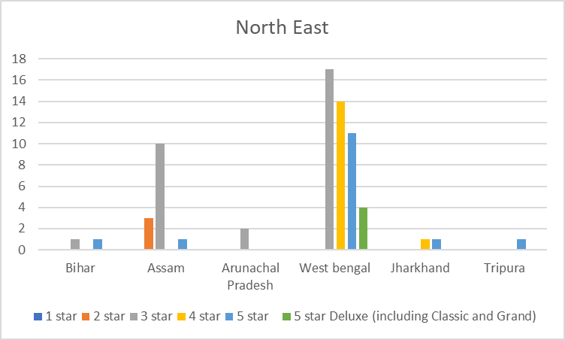
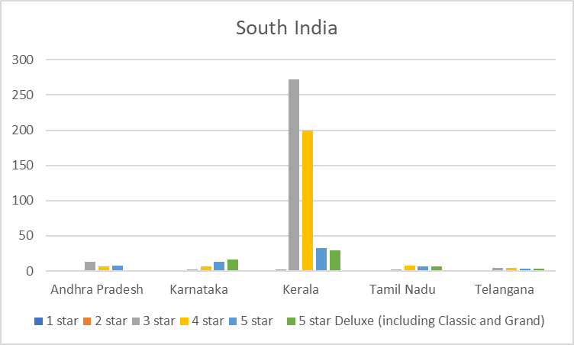
North East India
South India
Negligible hotels in North East - Manipur, Nagaland even had 0 approved hotels.
Comparatively more hotels in West Bengal due to Kolkata (business purposes).
Kerala has highest classical hotels in India - especially 3 and 4 star as a result of the government liquor policies.

Slide 8
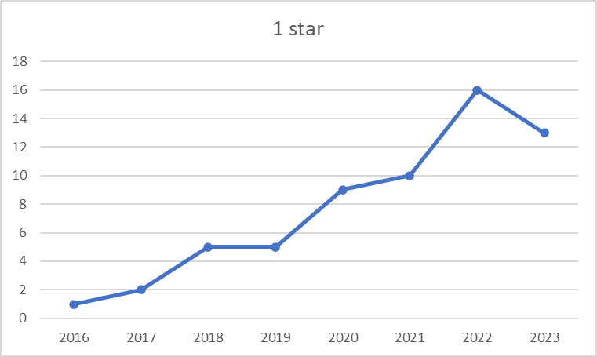
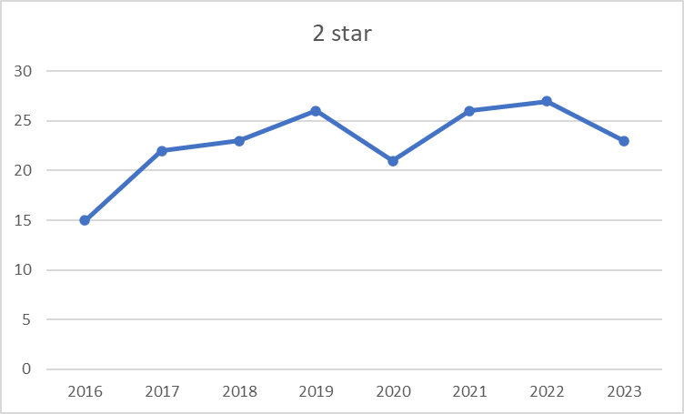
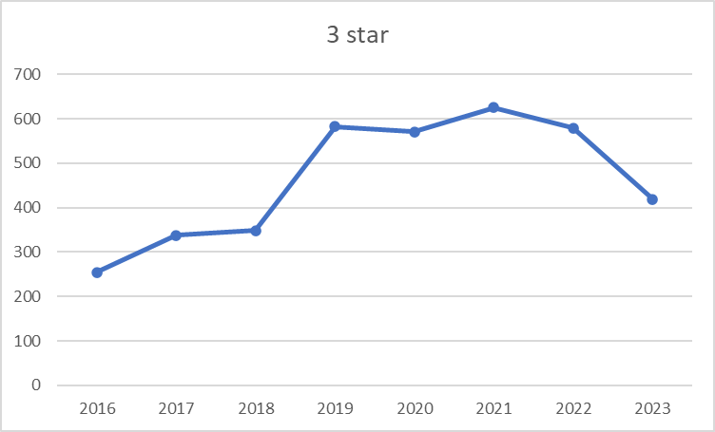
Distribution of Hotels across time
3 Star hotels Increased till covid, decreased after it significantly.
3 star hotels have highest count, they have good facilities with affordable prices, hence not much demand for 1 and 2 star hotels, therefore their count is less.
1 star hotels increased despite covid; 2 star ones remained more or less similar.

Slide 9
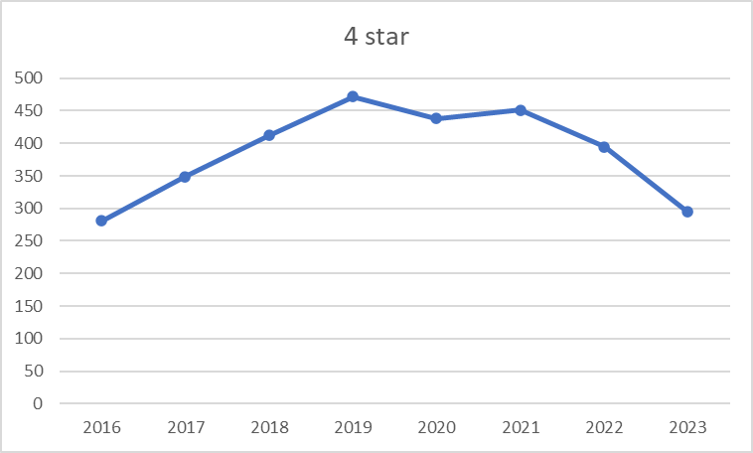
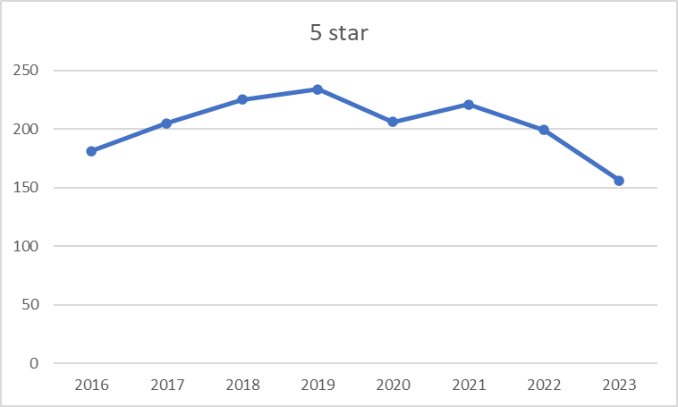
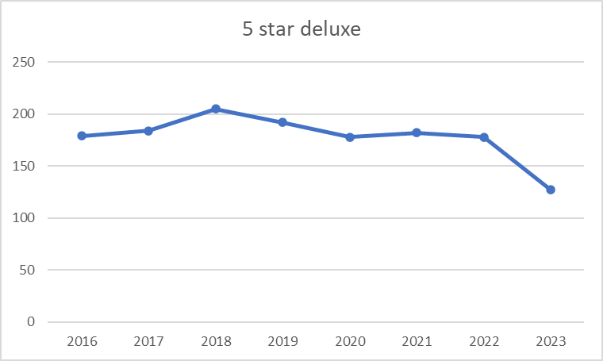
Distribution of Hotels across time
4 and 5 star hotels increased regularly till covid, then decreased.
5 star hotels’ count bit less than 3 and 4 star hotels.
Deluxe hotels don’t have much growth since 2016, Covid didn’t much affect their count since they are well established.

Slide 10
Spatial Temporal Distribution

Slide 11
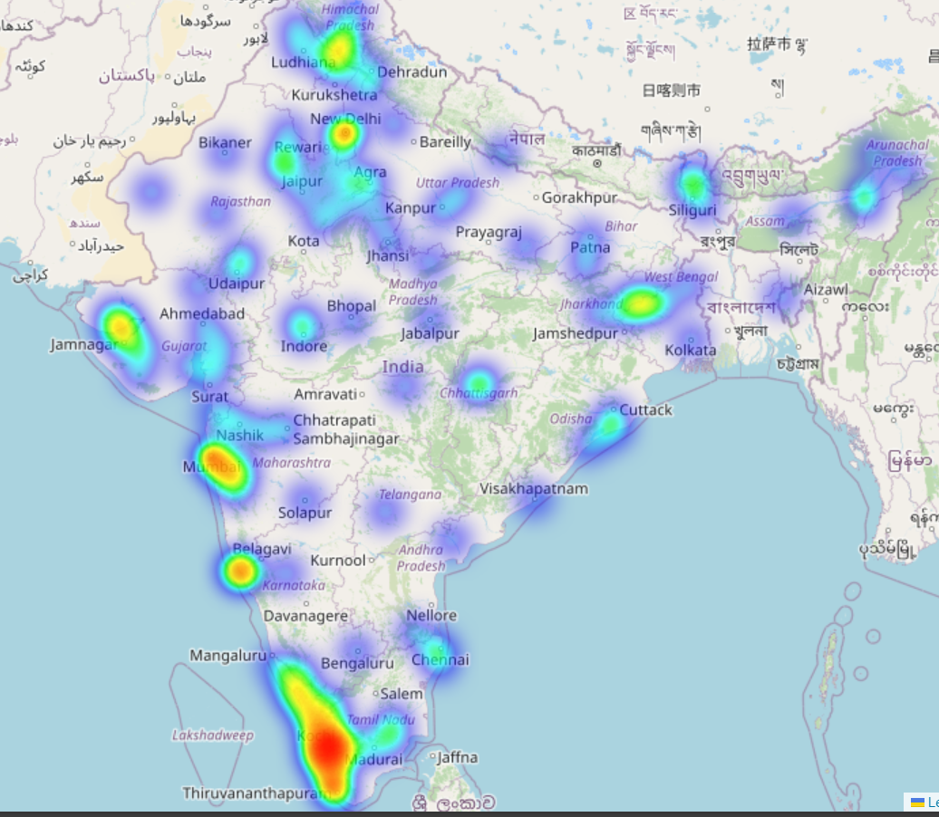
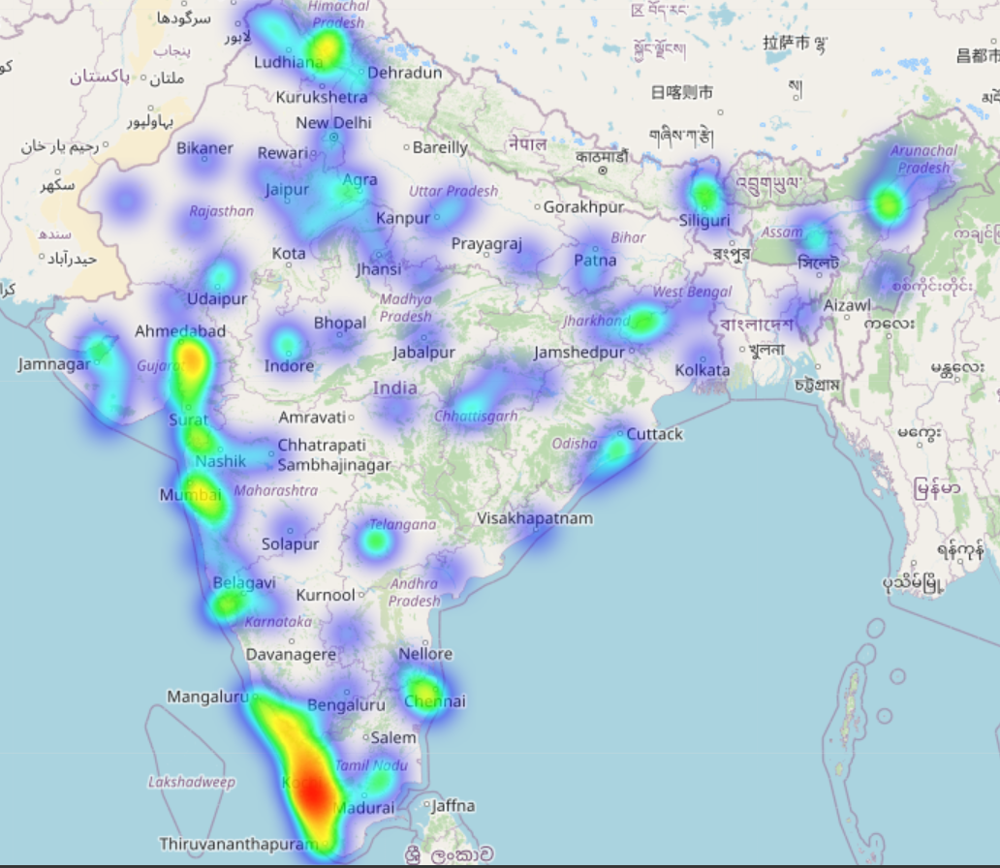
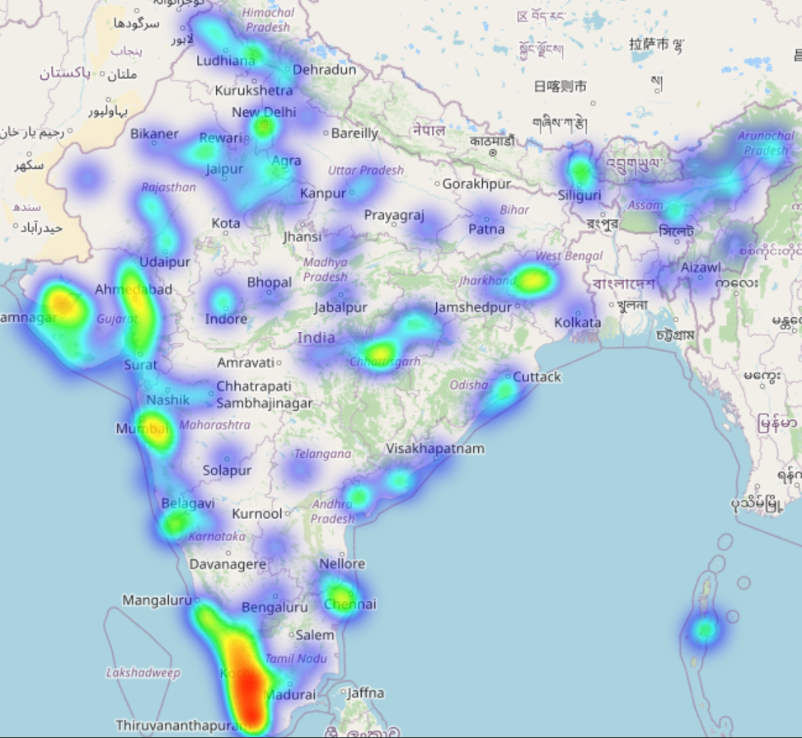
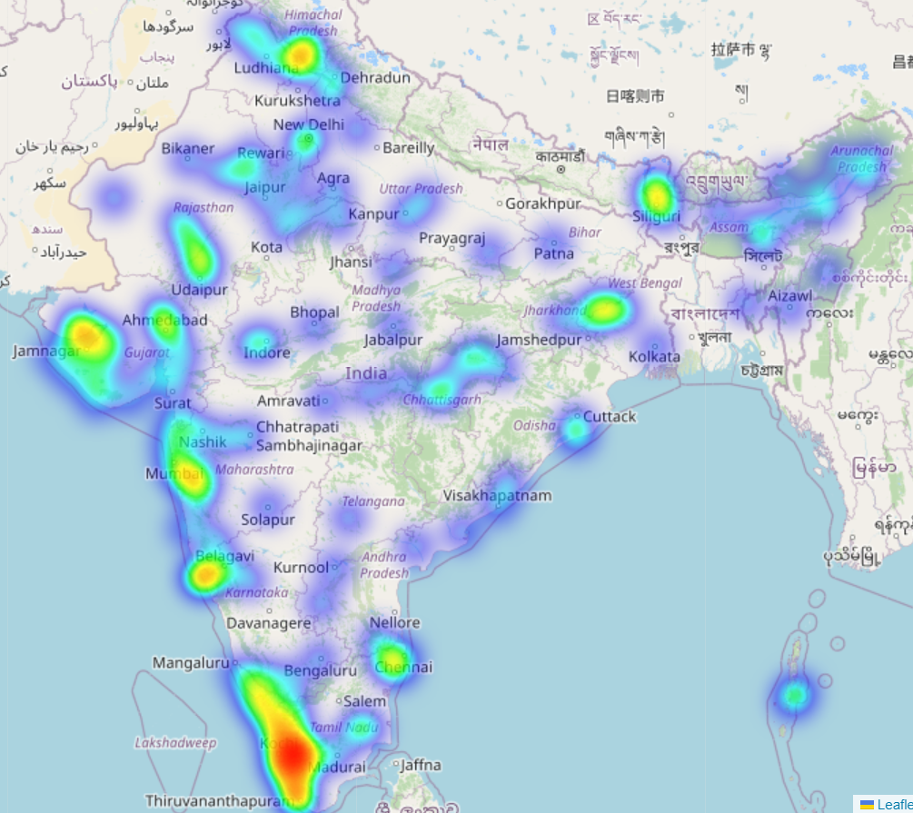
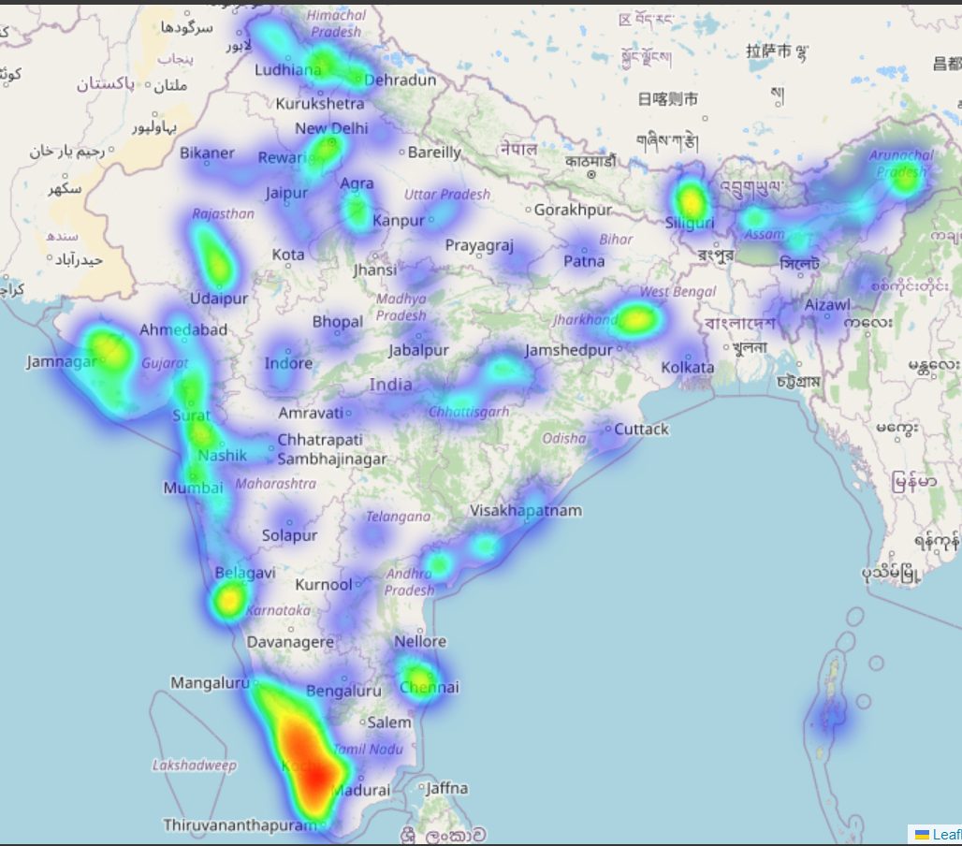
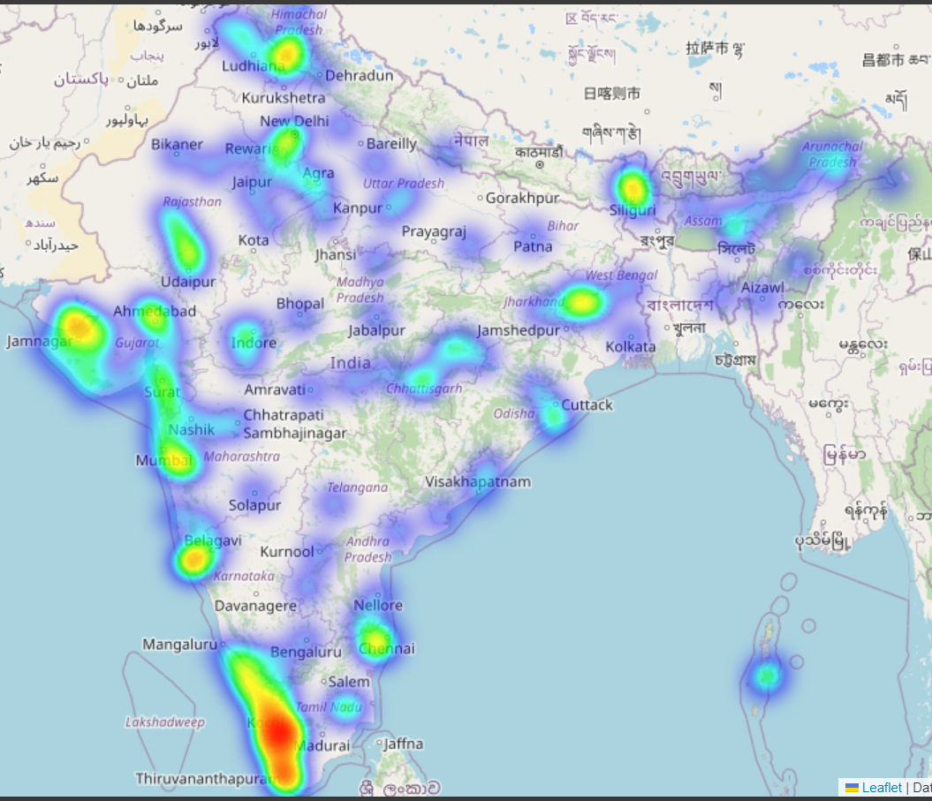
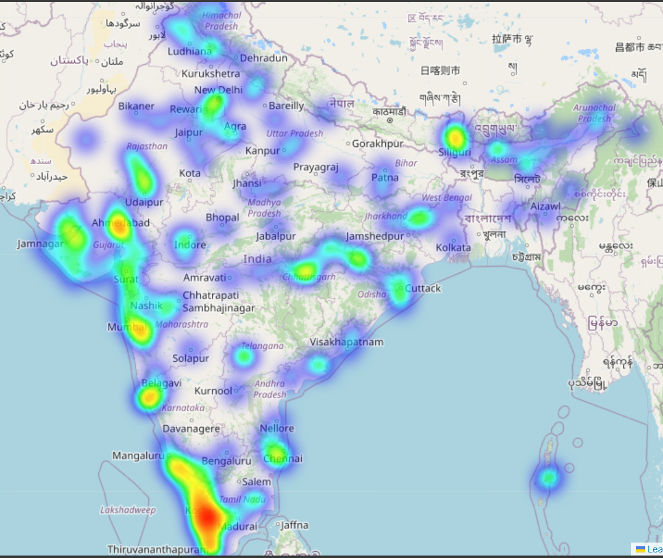
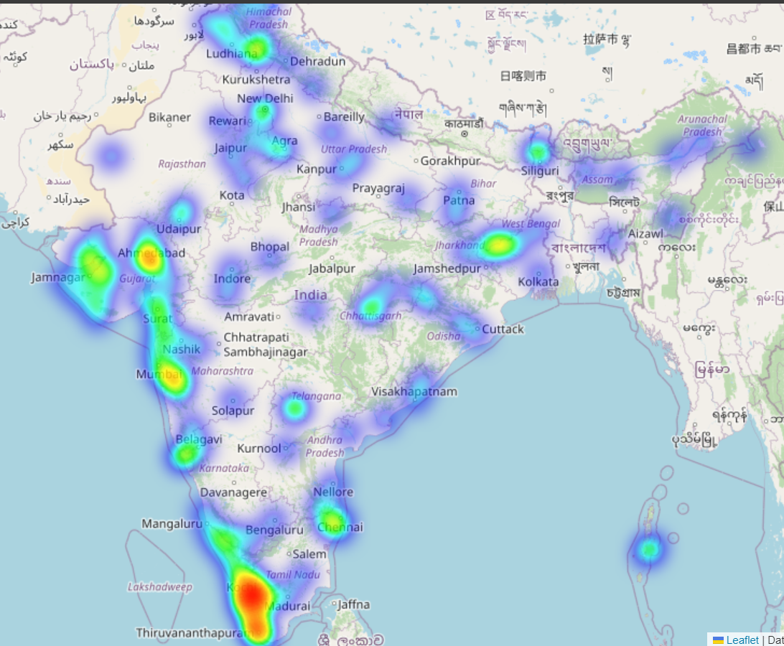
2016 2017 2018 2019
2020 2021 2022 2023
Generated HeatMaps of hotel counts over the years across India using folium python library.

Slide 12
Observations of the HeatMaps
Hotspots and distributions of hotels all over India are highlighted through these hotspots.
Some Key Observations:
Himachal Pradesh and Punjab - overall decrease in density
Chhattisgarh – constantly low count after 2018
Kerala - Overall high count, decrease after covid
Hotspot appeared in Jamnagar in 2018
Region | Pre-Covid | During Covid | Post-Covid
Ahmedabad | Increase | Decrease | Increase
Sikkim | Constant | Increase | Significant decrease
North East | Low count | Increase | Decrease
Jharkhand | Increase | Constant | Slight Decrease
Chennai | Constant (moderate) | Constant | Decrease
Mumbai | Increase | Decrease | Increase

Slide 13
MakeMyTrip Data Analysis

Slide 14
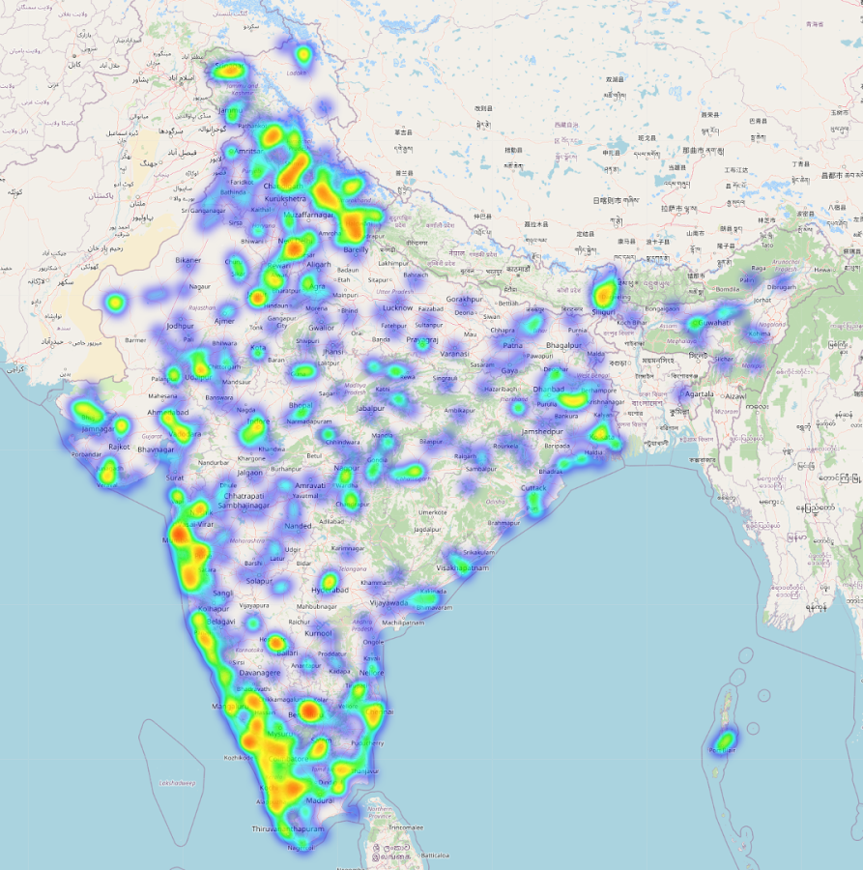
Need
Govt data had very few (nearly 1500) hotels as compared to real scenario (eg MakeMyTrip had around 20,000 hotels) since government data only has classical (approved) hotels.
Many more cities are now covered, and new hotspots are visible.
Though here also Kerala has lot of hotels (hotpot distribution nearly same) but we also got comparable hotspots in northern, western and southern India.

Slide 15
Distribution of Hotels across Indian states of MMT data

Slide 16
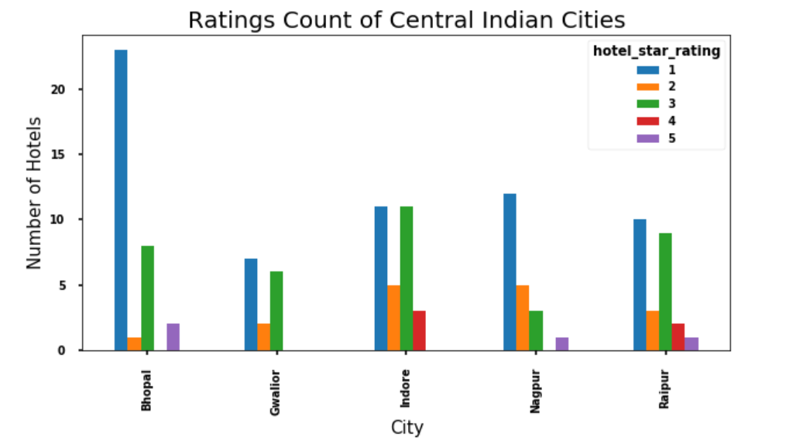
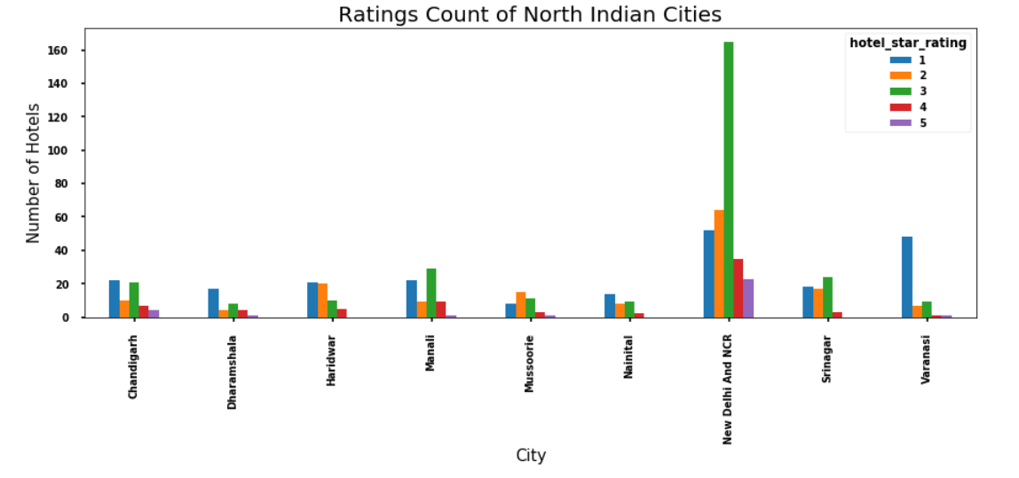
Overall number of hotels in central India is less.
Delhi dominant in north India except that 3 star hotels are very high (compared to govt data where 5 star were dominant).
Uttarakhand and HP cities have good hotels since they are tourist hotspots.

Slide 17
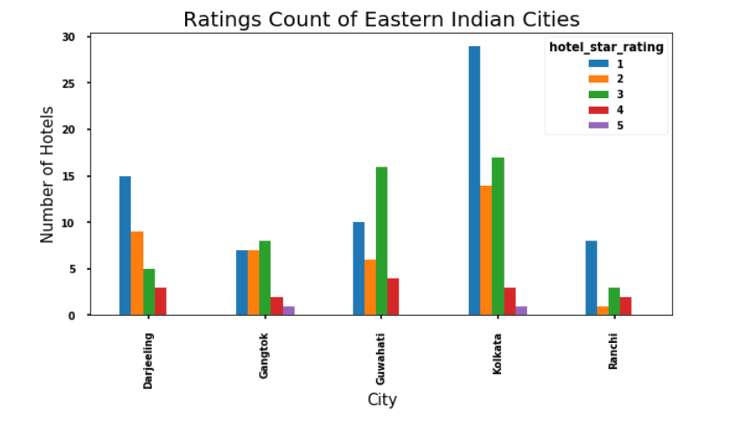
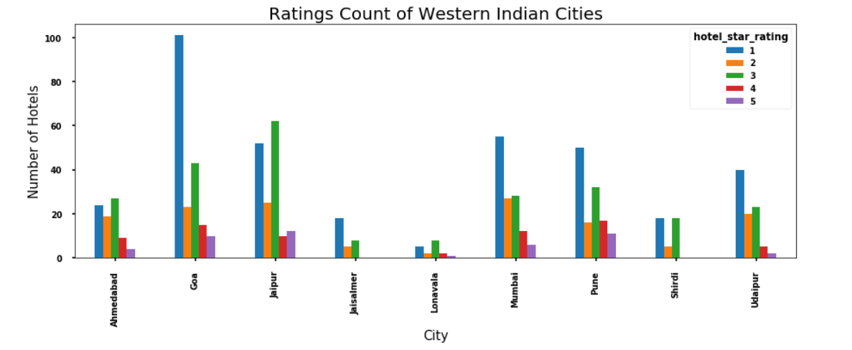
North east hotels number is overall less; Kolkata has highest (similar to govt data).
Goa has highest number due to tourism.
Western Maharashtra and Rajasthan also has a high count due to work client and tourists guests.
Overall high number of hotels in west India

Slide 18
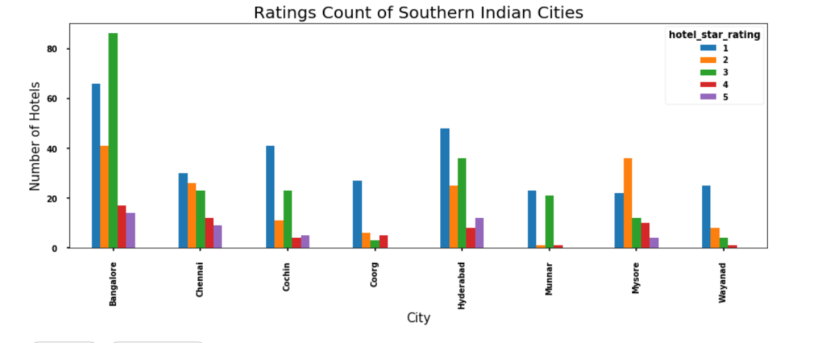
Here Kerala does not have the highest count (as in govt data)
Bangalore and Chennai have highest count which tells that hotels are evenly distributed in South India

Slide 19
Text Review Analysis using NLP

Slide 20
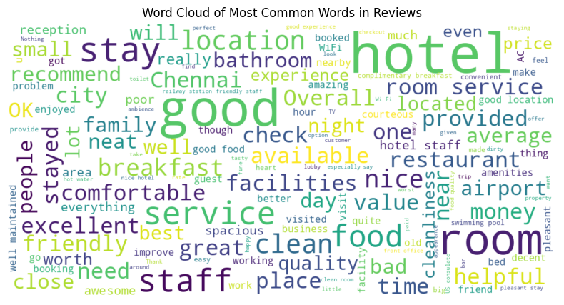
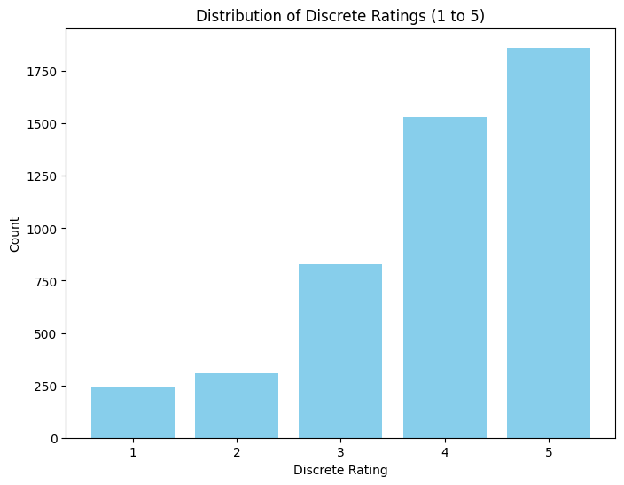
EDA and Distribution
Lot of >=3 star rating hotels are present in the data.
WordCloud suggests that room, service, location, breakfast, facilities are the aspects which are frequently mentioned in the reviews.
Aspects like swimming pool, hot water, TV, ambience, spacious are not much frequently used by customers in the reviews.

Slide 21
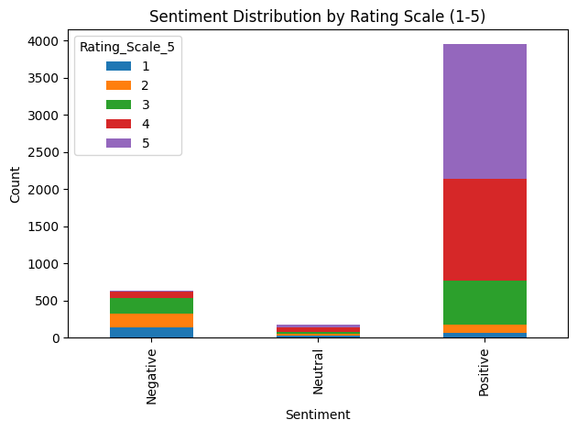
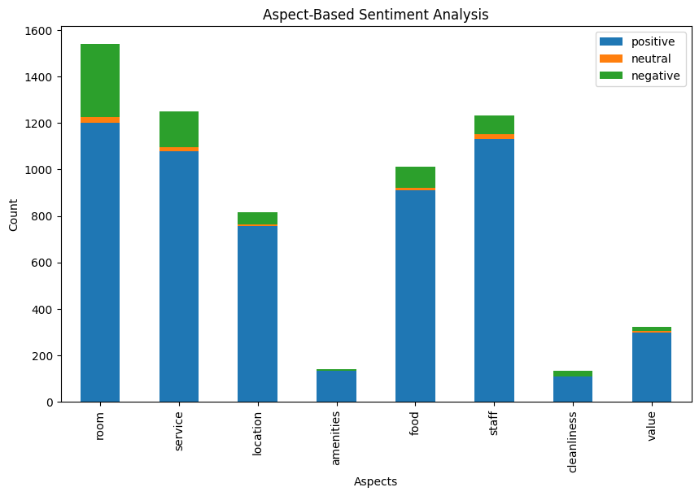
Sentimental Distribution and Aspect Based Analysis
Point-Biserial Correlation between Discrete Rating and Sentiment: 0.51
Most of the 5, 4 star reviews have positive sentiment while 2, 3 star have all kinds of sentiments.
Indian people mostly focus on room, service, food aspects, while cleanliness, amenities don’t matter much.

Slide 22
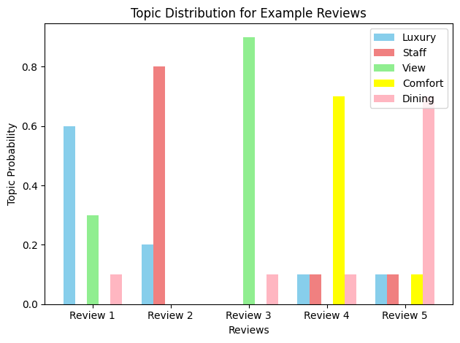
Topic Modelling
Review 1: "The hotel was really fancy! The view from the room was amazing, especially during the sunset. The food at the hotel's dining was superb."
Review 2: "Our stay at this hotel was fantastic! The staff was very cooperative and had a nice attitude."
Review 3: "I had a pleasant experience at this hotel. The view from our room was stunning. The dining options were great."
Review 4: "The hotel was comfortable and luxurious and the staff was very polite. The view from our room was spectacular, especially in the evening. The room was comfortable, and the dining options offered a range of delicious dishes."
Review 5: "We had a great time at the hotel. The staff was helpful and the view from our room was outstanding. The dining options were delightful with a variety of tasty dishes."
From all the reviews of our data, we found ‘Luxury, Staff, view, Comfort, Dining’ to be the most prominent topics.

Slide 23
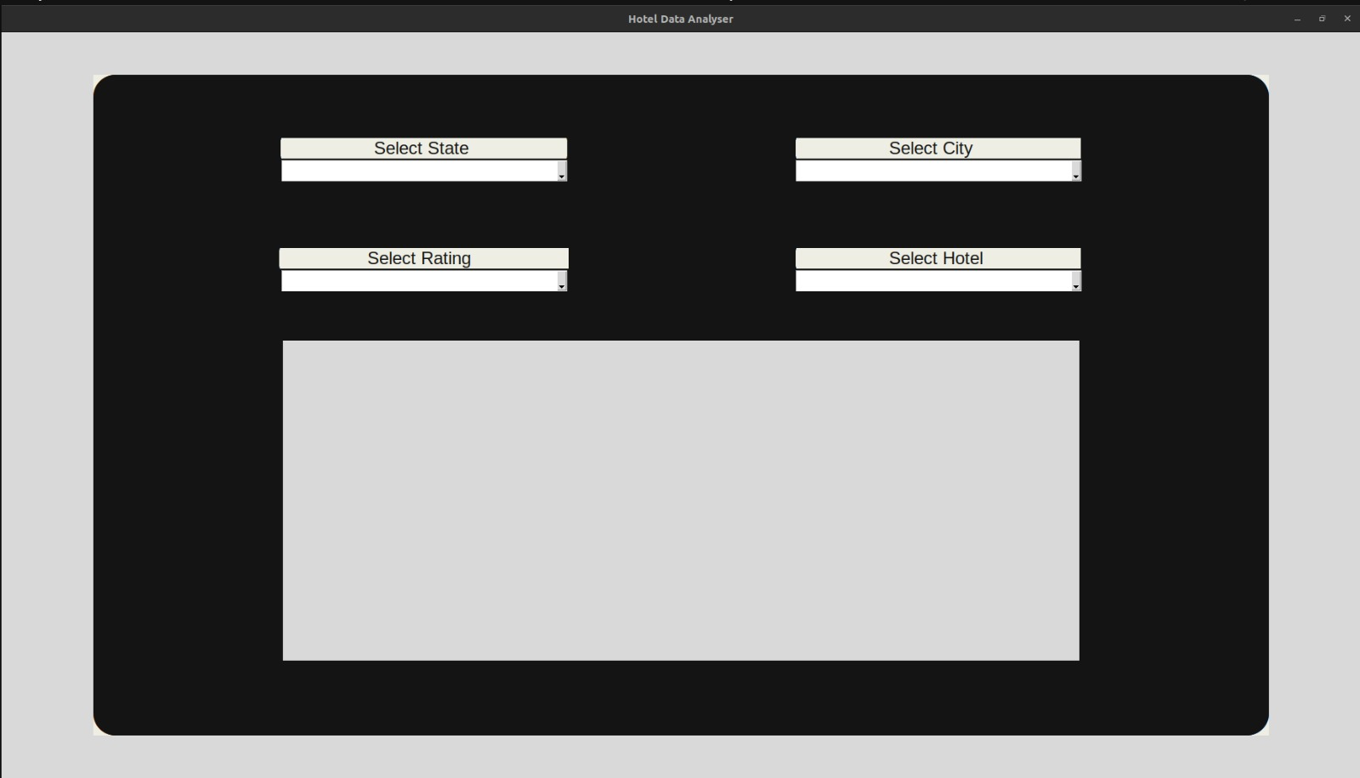
Graphical User Interface (GUI)

Slide 24
Targets for CheckPoint 3
Analyze Tourism data (like monumental visits) from Government websites for different states and perform correlation analysis with that of hotel data.
Deriving more insights from analysis done till now (if needed).
Improving GUI for better user accessibility, adding more functionalities.
Scrapping restaurants data and analyzing the same using statistical and NLP techniques similar to Hotel data.
Formulating a GUI for user friendly access of Restaurants data.

Slide 25
Conclusions
Hospitality industry concentrated in North, West and South India
3 star hotels have the highest count among all the ratings due to affordable prices and decent facilities
There is growth in industry, hindered by COVID, total count has decreased from 2019
The distribution of hotspots over time remains quite consistent with only minor variations
Govt. data is biased towards Kerala in South India
The number of approved hotels in India is significantly lower compared to the actual number of hotels.
Many more data points, more evenly distributed than Govt data

Slide 26
Conclusions
There is a significant disparity in the count of 1-star hotels on MMT compared to the govt. records.
There are limited 5-star hotels in Central India, primarily due to a lack of significant tourism, limited hospitality infrastructure, and the economic profile of the region
North East have significantly low count except Kolkata due to geographic challenges, while Kolkata is a trade and educational and cultural hub
Ratings and review sentiments have correlation of 0.51 indicating a positive relation but not strong
EDA and aspect analysis show similar results in terms of topics of concern
Topic modelling predicts that most reviews focus towards a single dominant topic

Slide 27
References
https://nidhi.nic.in/MOT/Catrpt.aspx – Government Hotel Data
https://www.kaggle.com/code/kiranreddyrebel/hotel-city-visualization/notebook – Kaggle’s MakeMyTrip Data
https://www.kaggle.com/code/rjtmehta99/e-d-a-of-chennai-hotel-reviews – Kaggle’s Chennai Reviews Data
https://tourism.gov.in/sites/default/files/202209/India%20Tourism%20Statistics%202021%20(1).pdf – Govt Tourism Report

Slide 28
THANK YOU!

